Slide 1
Objective
The goal of this project is to build a machine learning model that can classify news articles as fake or real using Natural Language Processing techniques.
Data preprocessing
The label and text were in the same column → columns have been separated
Encoding issues ( "ï»¿0„ "â„ ) → encoding have been removed
Punctuation , numbers ,stopwords and extra spaces→ have been removed
Uppercase → Lowercase
Notes:
In this project we aime to classify real and fake news using NLP techniques .
As data preprocessing started by separating the text from the label because they where in the same column
I also face some encoding issues
Even thought I used latain 1 for the encoding , so I had to remove the special caracters

Slide 2
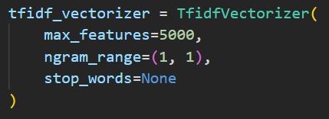
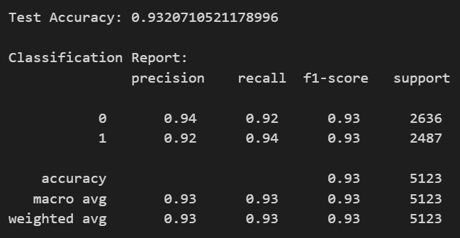

Baseline Model
Vectorization : IF-IDF
Test Accuracy : 93,2%
Model : Logistic regression
Notes:
I started the experiments with a simple and baseline model
we used TF-IDF vectorization with unigrams combined with Logistic Regression. This gave us a strong baseline accuracy of around 93%

Slide 3
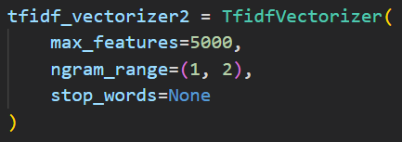
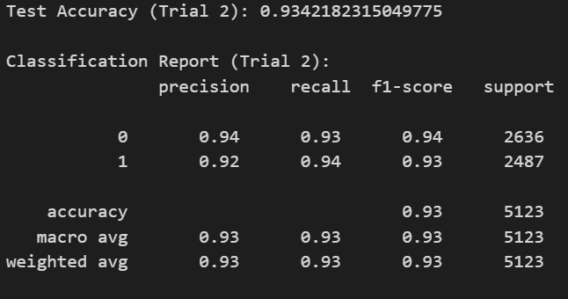
Baseline Model ngrams (1,2) instead of unigrams (1,1) only
Vectorization : IF-IDF
Test Accuracy : 93,4%
Model : Logistic regression
Insights :
Capturing phrases matters. Some news patterns like "breaking news", "fact check" are strong indicators of fake/real news.
Notes:
Then, I improved the vectorization adding bigrams and This slightly improved the performance but showed that Capturing phrases like "breaking news", "fact check“matters and can be a strong indicators of fake/real news.

Slide 4
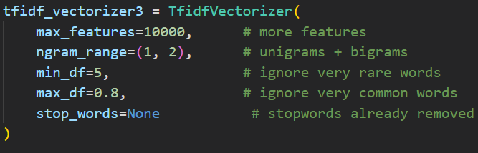
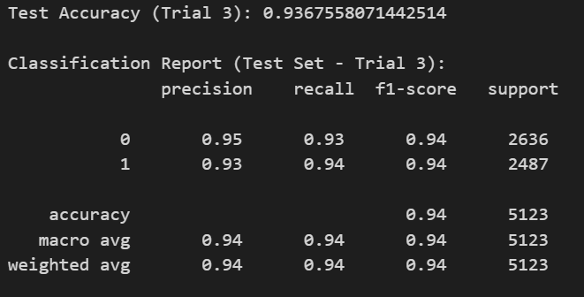

Baseline Model
Tuned TF-IDF parameters
Vectorization : IF-IDF
Test Accuracy : 93,6%
Model : Logistic regression
Insights :
Increasing max_features allows the model to consider more word.
Ignoring the very rare words and very common words removes noise.
Notes:
Tuned TF-IDF parameters such as Increasing the number of features that allows the model to consider more word.
Ignore the very rare words and very common words that helped to remove the noise. This change has also increased the accuracy to reach 93.6

Slide 5
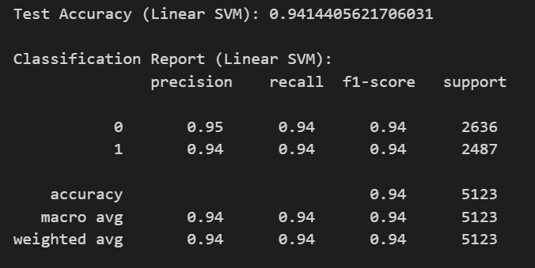

Linear SVM ( support vector machine ) Model
Vectorization : IF-IDF
Test Accuracy : 94,1%
Model : Linear SVM
Notes:
The real game changer was replacing Logistic Regression with a Linear Support Vector Machine while keeping the same TF-IDF configuration. This change led to a clear jump in accuracy.

Slide 6
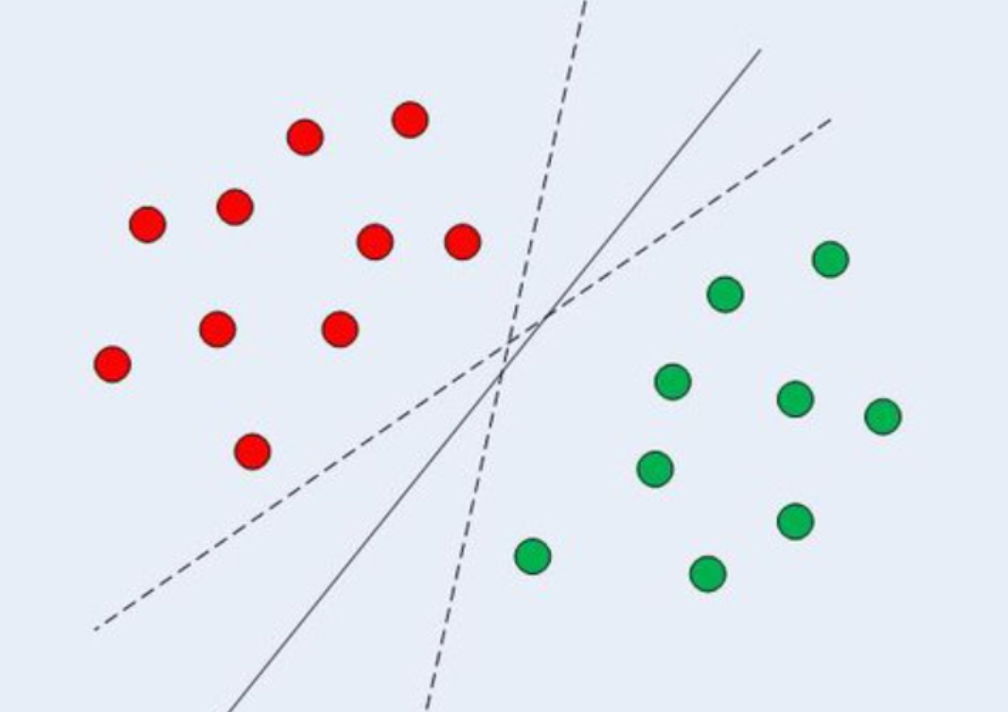
Insights :
The linear SVM outperforms Logistic regression because it finds the optimal classification boundary by maximizing the margin between classes leading to a better generalization on unseen data
Compared to logistic regression which estimates probabilities and may draw multiplue decision boundaries.
Notes:
The reason is that Linear SVM focuses on finding the optimal decision boundary by maximizing the margin between the two classes , in the bellow image there are multiple decision boundaries that will do the job of classification but the filled one is better than the dashed ones since it divides the points while leaving enough room for potential outliers or unseen data .
An SVM tries to draw this optimum decision boundary while logistic regression might draw any one of those dashed boundaries which might cause classification errors for outliers.

Slide 7
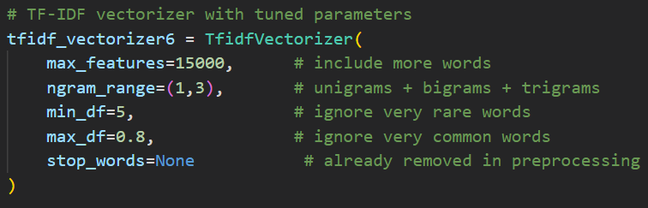
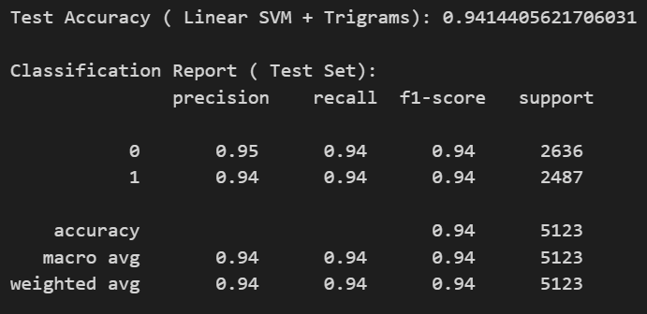
Linear SVM ( support vector machine ) Model
Tuned TF-IDF parameters
Vectorization : IF-IDF
Test Accuracy : 94,1%
Model : Linear SVM
Insights :
The test accuracy didn’t change , we reached the features saturation
Notes:
In this trial I fine-tuned the TF-IDF, but the accuracy stayed the same, which shows that we reached feature saturation and extracted most of the useful information

Slide 8
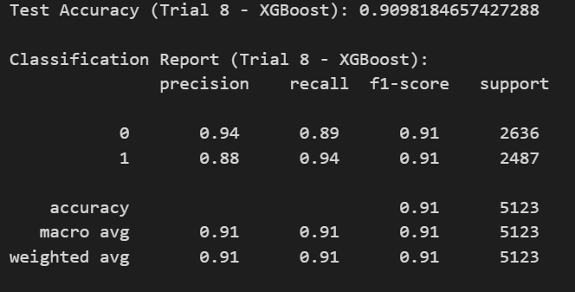
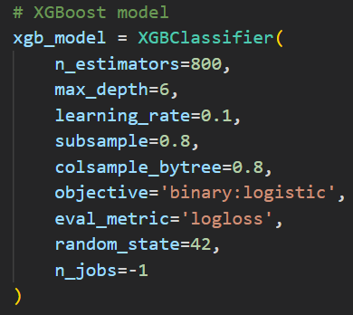
XGBoost
Vectorization : IF-IDF
Test Accuracy : 90,9%
Model : XGBOOST
Notes:
i also tested more complex models like XGBoost , and SGD classifier to see if they could improve performance. However, these models did not outperform the Linear SVM.

Slide 9
Insights :
XGBoost did not outperform the Linear SVM because TF-IDF transforms each article into a high-dimensional vector, where most values are zero.
Tree-based models like XGBoost waste splits on irrelevant features,( zeros ) and that is when it becomes inefficient .
Notes:
This is because our data becomes high-dimensional with most values equal to zero after the vectorization, which is not good handled by the tree based models they waste time on splitting irrelevant features ( zeros ) and that is when they become inefficient

Slide 10
Trials Comparison
Trial | Vectorization | TF-IDF Parameters | Model | Accuracy
Trial 1 | TF-IDF | unigrams (1,1), max_features=5000 | Logistic Regression | 93.2%
Trial 2 | TF-IDF | unigrams + bigrams (1,2), max_features=5000 | Logistic Regression | 93.4%
Trial 3 | TF-IDF | (1,2), max_features=10000, min_df=5, max_df=0.8 | Logistic Regression | 93.6%
Trial 4 | TF-IDF | (1,2), max_features=10000, min_df=5, max_df=0.8 | Linear SVM | 94.14%
Trial 5 | TF-IDF | (1,3), max_features=15000, min_df=5, max_df=0.8 | Linear SVM | 94.14%
Trial 6 | TF-IDF | (1,2), max_features=10000, min_df=5, max_df=0.8 | XGBoost | 90%
Notes:
Based on these experiments, we selected the Linear SVM with TF-IDF vectorization as our final model, as it offered the best

